Slide 1




IT250 MINI PROJECT
Nithin S 221IT085
Ayush Kumar 221IT015
Jay Chavan 221IT020

Slide 2

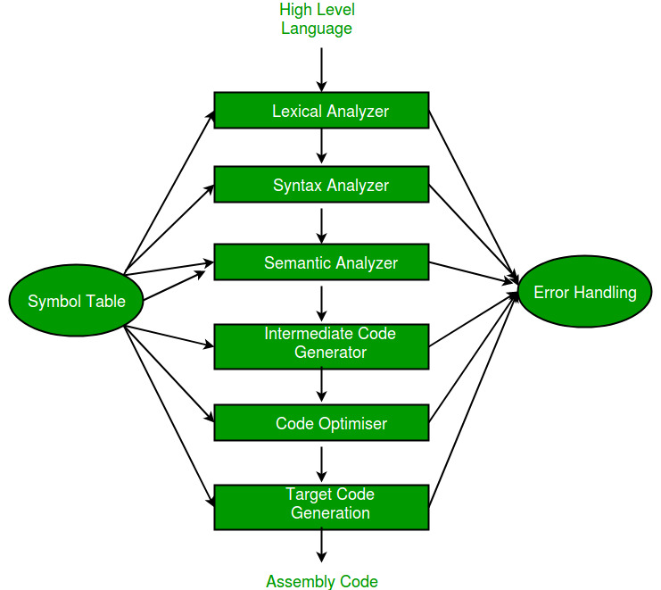

COMPILER
A compiler is a special program that processes statements written in a particular programming language and turns them into machine language or "code" that a computer's processor uses.

Slide 3


PHASES OF A COMPILER
01
04
Intermediate Code Generator
Lexical Analyzer
02
Syntax Analyzer
05
Code Optimizer
03
06
Target Code Generator
Semantic Analyzer

Slide 4

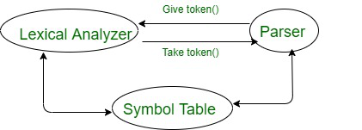

LEXICAL ANALYZER
Scans the Pure High Level Language Code Line by Line
Takes Lexemes as input and produces Tokens using DFA for pattern matching
Removes Comments and Whitespaces from the Pure High Level Code
Helps in macro expansion in the Pure HLL Code
Creates a Symbol Table

Slide 5
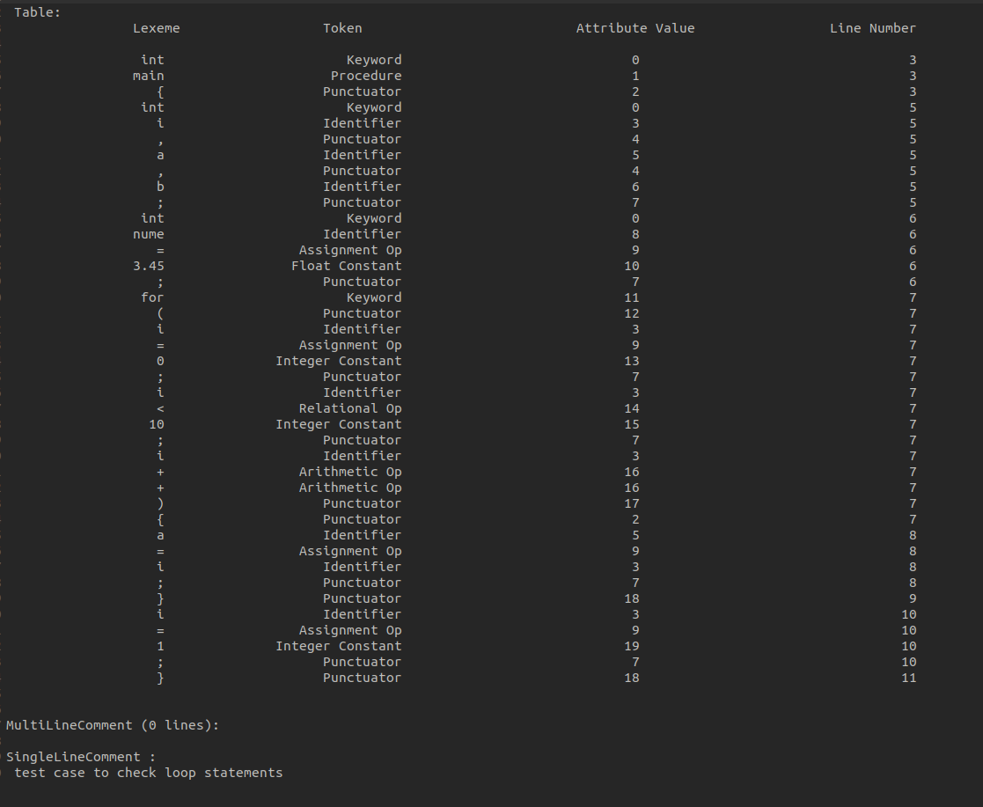
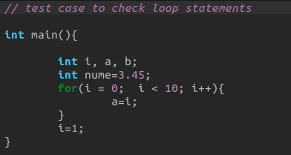
Input
Output

Slide 6
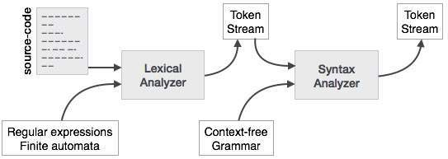
SYNTAX ANALYZER
Checks for syntactic errors like missing semicolons, mismatched parentheses, etc.
May involve resolving ambiguities in the grammar.
Implements parsing algorithms such as LL, LR, or Recursive Descent.
Constructs an Abstract Syntax Tree (AST) representing the hierarchical structure of the code.
Handles language features like function prototypes, declarations, and definitions.

Slide 7
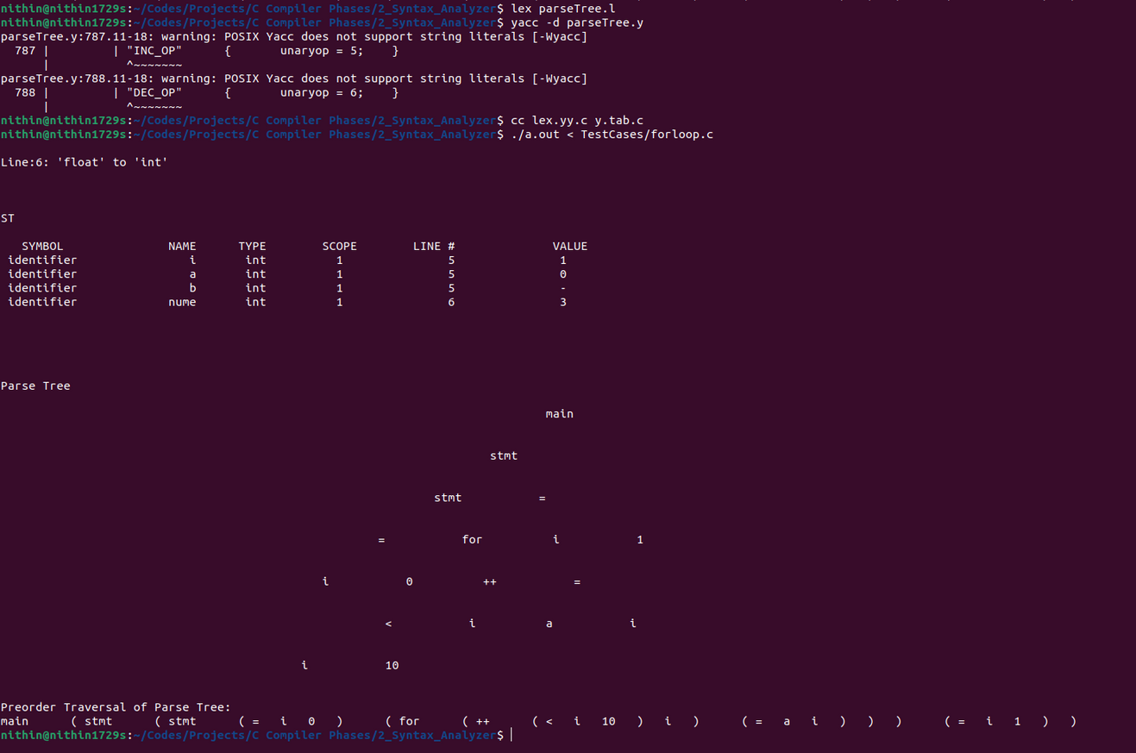
Input
Output

Slide 8
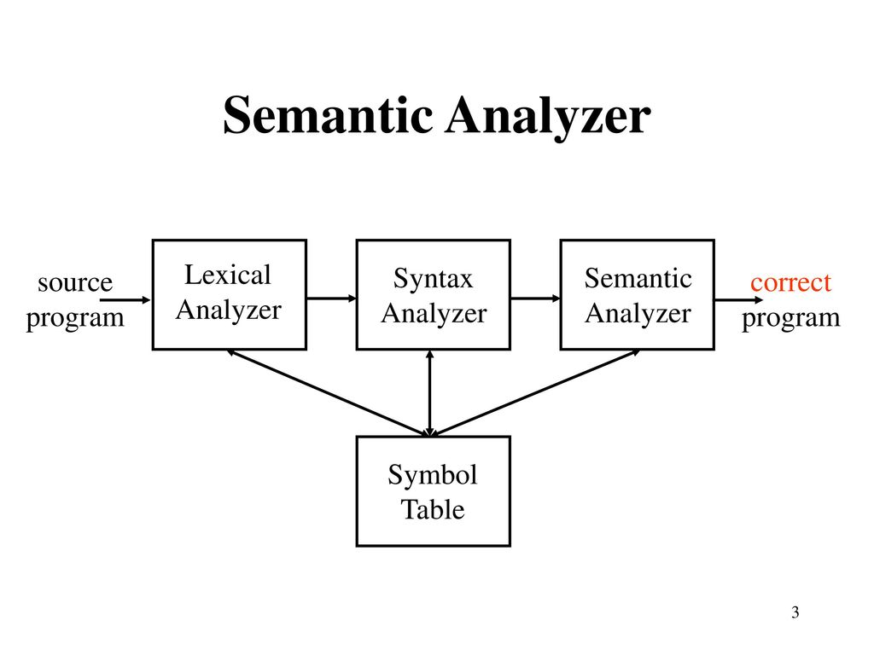


SEMANTIC ANALYZER
Performs type checking to ensure operations are performed on compatible types.
Handles scope and namespace resolution.
Detects and reports semantic errors such as type mismatches or undeclared variables.
Ensures that data types are used in a way consistent with their definition.
Keeps a check that control structures are used in a proper manner.(example: no break statement outside a loop)

Slide 9
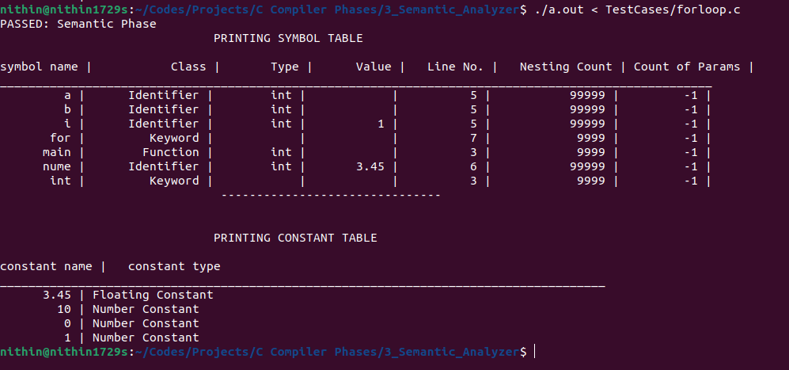
Input
Output

Slide 10

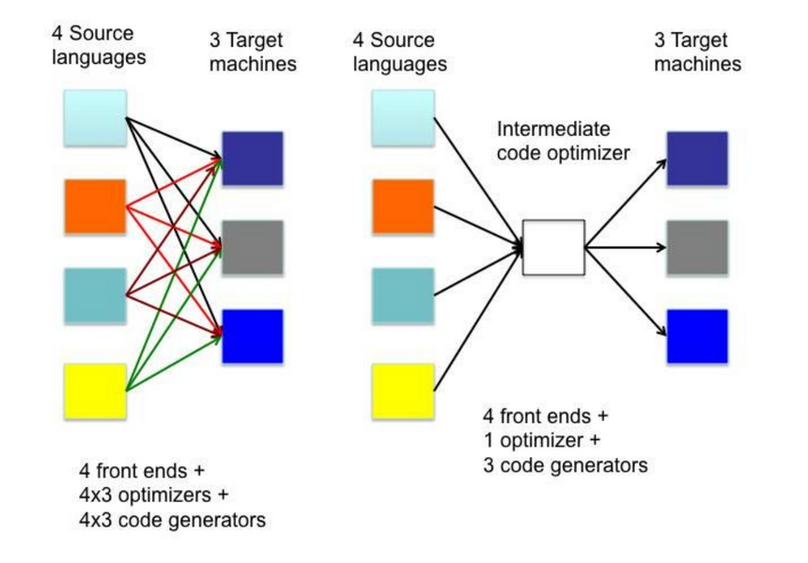
INTERMEDIATE CODE GENERATOR
Can generate different intermediate representations like Abstract Syntax Trees (AST), Quadruples, or Direct Abstract Graphs (DAG).
Handles complex language constructs like loops and conditionals.
Prepares the code for optimization by simplifying and restructuring it.
Optimizes control flow structures like loops and conditional statements.
Generates temporaries for intermediate results.
Handles function calls and parameter passing mechanisms.
Converts expressions into a more manageable form for optimization

Slide 11
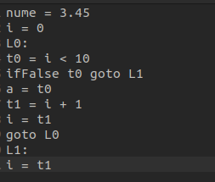
Input
Output

Slide 12

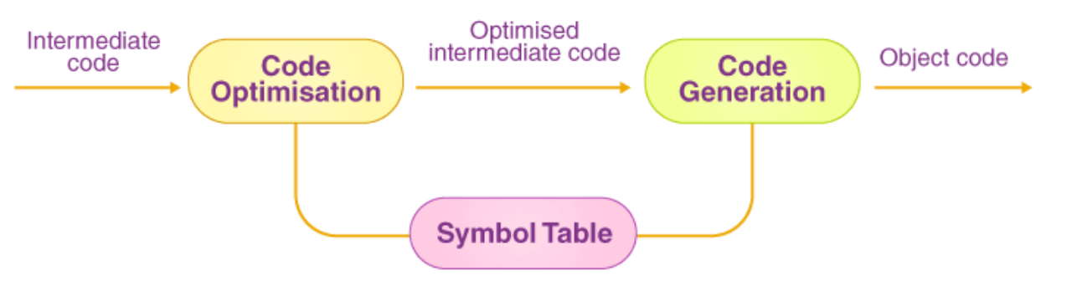
CODE OPTIMIZER
Exploits data locality for memory access optimization.
Applies loop transformations such as loop unrolling and loop fusion.
Utilizes profile-guided optimization for performance improvements.
Considers instruction scheduling to minimize pipeline stalls.
Incorporates inline expansion to reduce function call overhead.
Implements loop vectorization for exploiting SIMD (Single Instruction, Multiple Data) instructions.
Applies interprocedural optimizations across multiple translation units.
Considers speculative execution and branch prediction strategies.

Slide 13
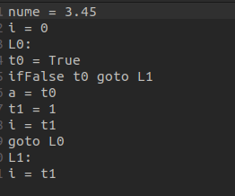
Input
Output

Slide 14
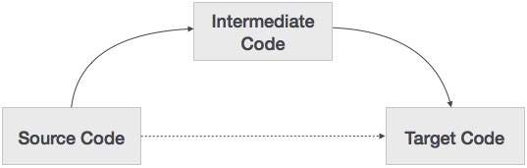
TARGET CODE GENERATOR
Resolves addressing modes and memory layout considerations.
Manages register allocation and spill code generation.
Optimizes instruction selection and scheduling for the target architecture.
Integrates platform-specific instruction sets and features.
Handles platform-specific binary formats such as ELF or COFF.
Manages symbol resolution and relocation for linking.
Supports generation of position-independent code (PIC) for shared libraries.
Integrates runtime support for exception handling and dynamic memory management.

Slide 15
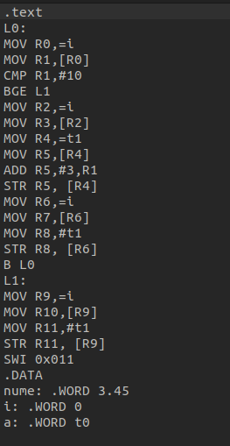
Input
Output

Slide 16
Conclusion
With the lex and yacc tool one can create its own compiler, wherever one is required.
It is basically procedural language compiler tools and to support object oriented one need to work on structure of C language to support object oriented which makes the compiler quite complex.
To use lex and yacc on UNIX is easy as compared to other operating systems. Gcc is the basic compiler to generate the executable from lex and yacc compiled files.
By studying these tools one can understand the basic structure of the compiler designed in C and go forward from it.

Slide 17
Future Scope
Machine Learning Based Optimization
Quantum Computing Compilation
Heterogenous Computing Compilation
High Level Synthesis
Domain Specific Compilation

Slide 18



THANK YOU

